Slide 1
Group 4
SINGAPORE, SHANGHAI, AND DUBAI
Comparatives and superlatives

Slide 2
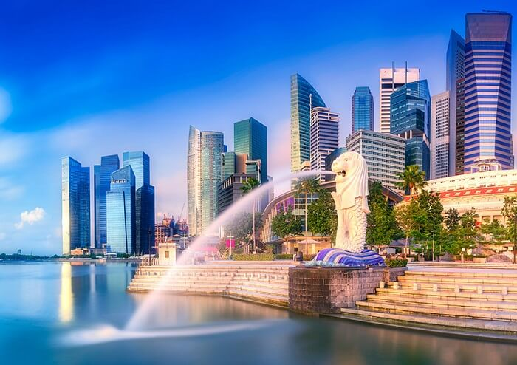

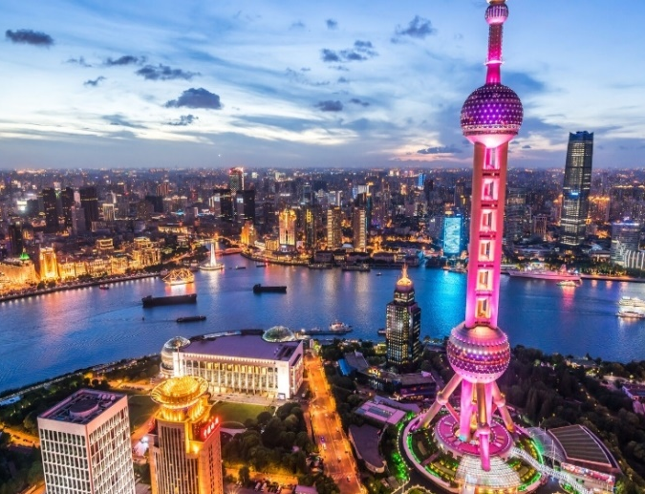
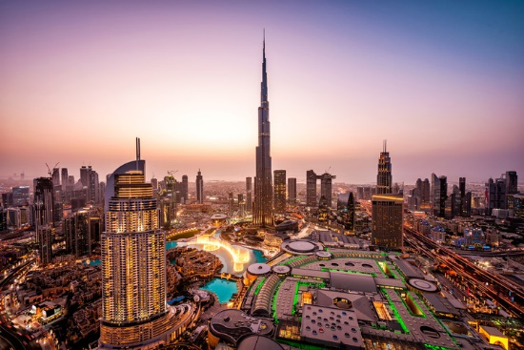
Exercise 1. Mia also went to Singapore and Dubai. Listen and
complete some of the things she says.
THE CITY Singapore is older than Shanghai, but it's _______ smaller. Shanghai is _______ bigger than Singapore and ______ noisier too.
BUSINESS They're both top financial centres, but Singapore is ______ important. It's better for investment.
BUILDINGS AND PEOPLE Shanghai is more _________ than Singapore, but it isn't as cosmopolitan. Dubai is _____ newest and __________ city, and it’s the most _________.
CLIMATE Singapore is ______________than Shanghai. But it isn't _____ hot ______ Dubai. Dubai is the _________ place. Singapore is very humid, so it’s _________ than Shanghai. But Dubai is the ______ . It only rains for a few days a year.
WHICH IS BEST? For me Shanghai is the ______ because it's the ______ and the ______ exciting.
a lot
much
much
more
modern
the
youngest
modern
a lot hotter
as
as
hottest
wetter
driest
best
busiest
most

Slide 3
Exercise 2. Listen again and check. What extra information do you hear?
Singapore is very old. It's older than Shanghai, but it's a lot smaller. Shanghai has a population of 20 million, and it's much bigger than Singapore, and much noisier, too.
Singapore and Shanghai are top financial centres, but Singapore is more important. It's better for investment.
There are a lot of new buildings in Shanghai, so it's more modern than Singapore, but it isn't as cosmopolitan. Half the population of Singapore are foreigners.
Dubai is the newest and youngest city, and it's the most modern.
Singapore is very near the equator, so it's a lot hotter than Shanghai. But it isn't as hot as Dubai. Dubai is the hottest place. Singapore is very humid, so it's wetter than Shanghai. Dubai is the driest. It only rains for a few days a year.
Shanghai is the busiest and the most exciting. It's got everything, the best restaurants, theatres, shops…

Slide 4
Exercise 3. What questions was Mia asked about each topic in exercise 1? Ask and answer them with a partner.
Q. What did you think of Singapore? What's it like?
A. Well, Singapore is very old. It's older than Shanghai, but it's a lot smaller. Shanghai has a population of 20 million, and it's enormous! Shanghai is much bigger than Singapore, and it's much noisier, too.
Q. Oh, OK What about business? What's it like to
do business in these places?
A. Well, they're both top financial centres, but Singapore is more important. It's better for investment.
Q. Ah, right. And the buildings? Are they all new?
A. Yeah, there are a lot of new buildings in Shanghai, so it's more modern than Singapore,
but it isn't as cosmopolitan. Half the population of Singapore are foreigners.
Q. Wow! Really? What about Dubai? What's
that like?
A. Dubai is the newest and youngest city, and it's the most modern. I like it because it has a 'can-do’ feel to it.

Slide 5
Q. What about the climate in these places? What
was the weather like?
A. It's interesting. Singapore is very near the equator, so it's a lot hotter than Shanghai. But it isn't as hot as Dubai. Dubai is the hottest place. When I was there the temperature was over 40 degrees.
Q. Wow! That's incredible!
A. Singapore is very humid, so it's wetter than Shanghai. But Dubai is the driest. It only rains for a few days a year.
Q. Where did you like most of all? Where was
best for you?
A. For me Shanghai is the best because it's the busiest and the most exciting. There are so many things to do- the best restaurants, theatres, shops. It's got everything!

Slide 6
Grammar spot
1. What are the comparative and superlative forms of these adjectives?
Adjectives | Comparative | Superlative
Old
Small
New
Busy
Noisy
Dry
Big
Wet
Important
Modern
Exciting
Older
Smaller
Newer
Busier
Noisier
Drier
Bigger
Wetter
More important
More modern
More exciting
The oldest
The smallest
The newest
The busiest
The noisiest
The driest
The biggest
The wettest
The most important
The most modern
The most exciting

Slide 7
When do we use -er and -est? When do we use more and the most?
I. Comparatives compare one thing. person, or action with another.
For short adj: She's taller than me.
For long adj: London's more expensive than Rome.
2. We use superlatives to compare somebody or something with the whole group.
For short adj: She's the tallest in the class.
For long adj: It's the most expensive hotel in the world.
For short adjectives with one vowel + one consonant, double the
consonant: hot/hotter/hottest ; fat/fatter/fattest.
Than is often used after a comparative adjective :
Ex. I'm younger than Barbara.
The is used before superlative adjectives :
Ex. He's the funniest boy in the class.

Slide 8
2. These adjectives are irregular. What are the comparative and superlative forms?
GOOD
BAD
FAR
BETTER
WORSE
FURTHER
THE BEST
THE WORST
THE FURTHEST

Slide 9
It a bit/a little bigger.
It's a lot/much smaller.
It's isn't as hot as Dubai.
3. Look at these patterns.
As ... as shows that something
is the same or equal.
Ex. Jim's as tall as Peter.
I'm as worried as you are
Not as ... as shows that something isn't the same or equal.
Ex. She isn't as tall as her mother.
He isn't nearly as clever as me!
Much/ a bit/ a lot can come before the comparative to give emphasis or modification.
Ex. She's a bit taller than her sister.
Is Tokyo much more modern than London?

Slide 10
THANK YOU FOR LISTENING !

